Slide 1
Office 365 Attacks
Prepared by @JohnLaTwC
v1.06

Slide 2
Attack Matrix for O365

Slide 3
Recon
Compromise
Persistence
Expansion
Actions on Intent
AAD | Dump users and groups with Azure AD | Password Spray: MailSniper Password Spray: CredKing
O365 | Get Global Address List: MailSniper Find Open Mailboxes: MailSniper User account enumeration with ActiveSync Harvest email addresses Verify target is on O365, [DNS], [urls], [list], [getuserrealm] Enumerate usernames, 2FA status via ActiveSync [o365userenum] Role, group, admin enumeration with Get-MsolRoleMember [RainDance] | Bruteforce of Autodiscover: SensePost Ruler Phishing for credentials Phishing using OAuth app 2FA MITM Phishing: evilginx2 [github] | Add Mail forwarding rule Add Global Admin Account Delegate Tenant Admin | MailSniper: Search Mailbox for credentials Search for Content with eDiscovery Account Takeover: Add-MailboxPermission Pivot to On-Prem host: SensePost Ruler Exchange Tasks for C2: MWR Send Internal Email | MailSniper: Search Mailbox for content Search for Content with eDiscovery Exfil email using EWS APIs with PowerShell Download documents and email Financial/wire fraud
End Point | Search host for Azure credentials: SharpCloud |  | Persistence through Outlook Home Page: SensePost Ruler Persistence through custom Outlook Form Create Hidden Mailbox Rule [tool]
On-Prem Exchange | Portal Recon Enumerate domain accounts using Skype4B, [LyncSmash] Enumerate domain accounts: OWA & Exchange Enumerate domain accounts: OWA: FindPeople OWA version discovery | Password Spray using Invoke-PasswordSprayOWA, EWS, Atomizer Bruteforce of Autodiscover: SensePost Ruler PasswordSpray Lync/S4B [LyncSniper] | Exchange MTA | Search Mailboxes with eDiscovery searches (EXO, Teams, SPO, OD4B, Skype4B) Delegation
Prepared by @JohnLaTwC, May 2019, v1.06

Slide 4
Public Tools and Techniques
What follows is a list of attack techniques for O365, on-prem exchange/OWA, and some Office application layer client-and-cloud techniques

Slide 5
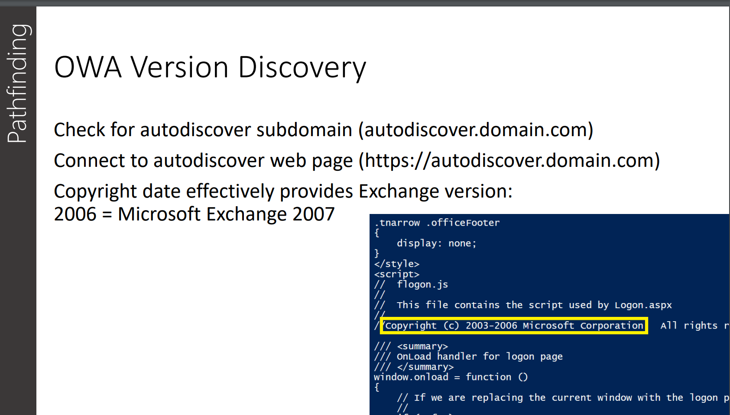
Recon: Fingerprint OWA/Exchange version
https://adsecurity.org/wp-content/uploads/2017/07/2017-DEFCON-HackingTheCloud-SteereMetcalf-Final.pdf

Slide 6
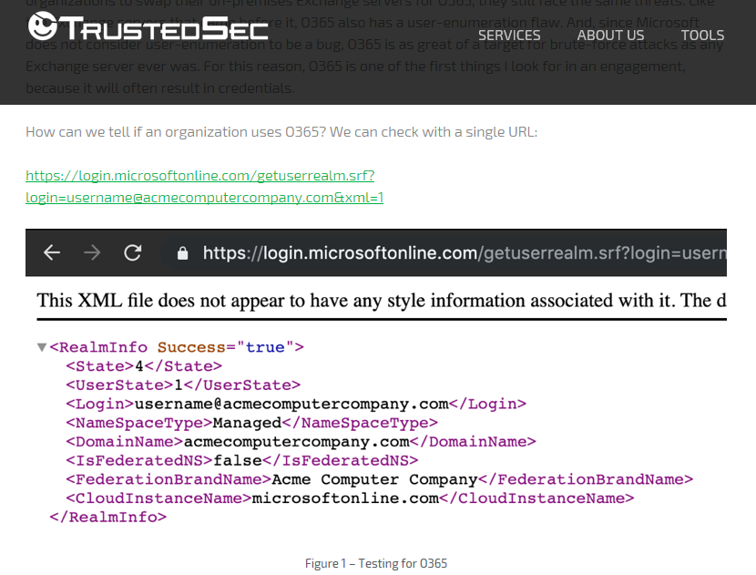
Recon: Verifying Target is on O365
https://www.trustedsec.com/2019/05/owning-o365-through-better-brute-forcing/

Slide 7
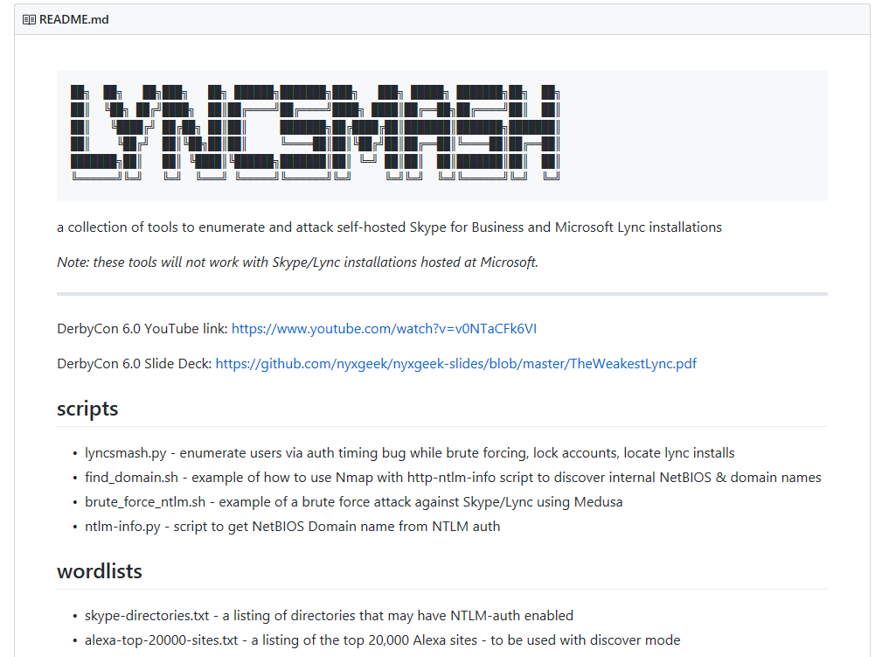
Recon: Enumerate users with LyncSmash
https://github.com/nyxgeek/lyncsmash

Slide 8
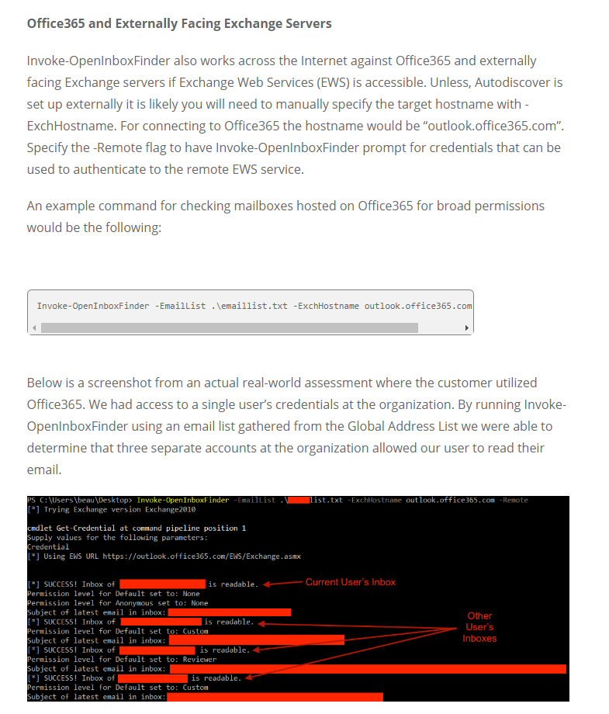
Recon: Find Open mailboxes
Mailboxes with relaxed permissions allow attackers to gain access
Attacker can search emails for credentials or victim information that facilitates targeting
Off-the-shelf tools exist to automate discovery
https://www.blackhillsinfosec.com/abusing-exchange-mailbox-permissions-mailsniper/

Slide 9
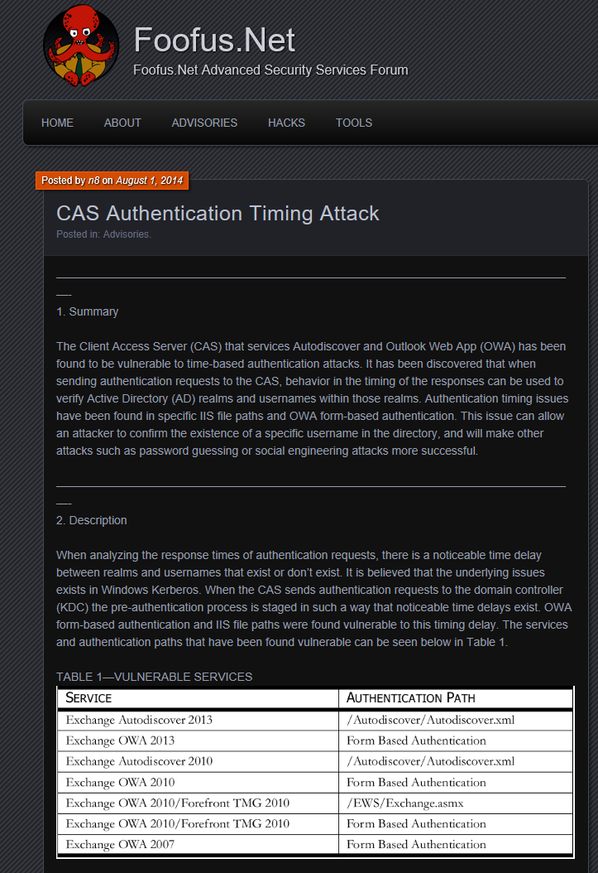
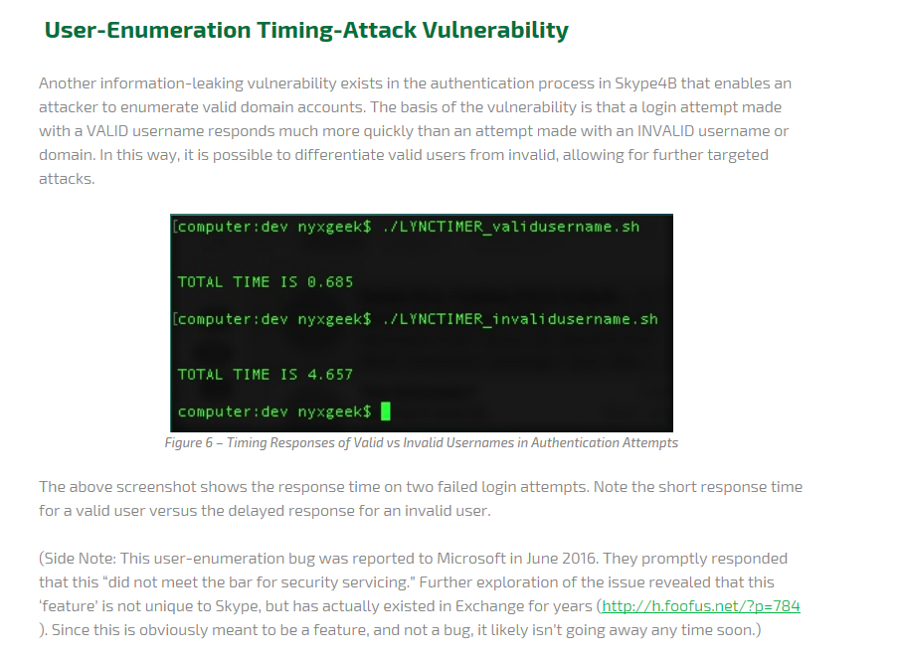
Recon: User Enumeration

Slide 10
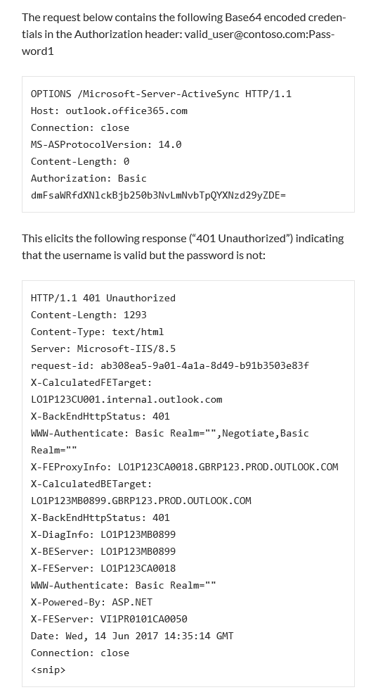
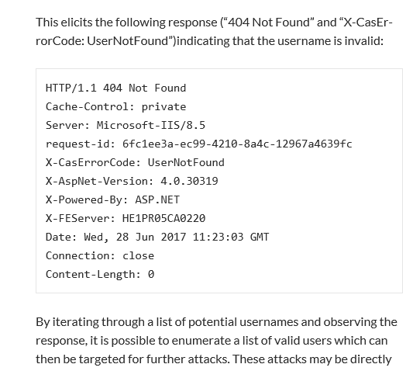
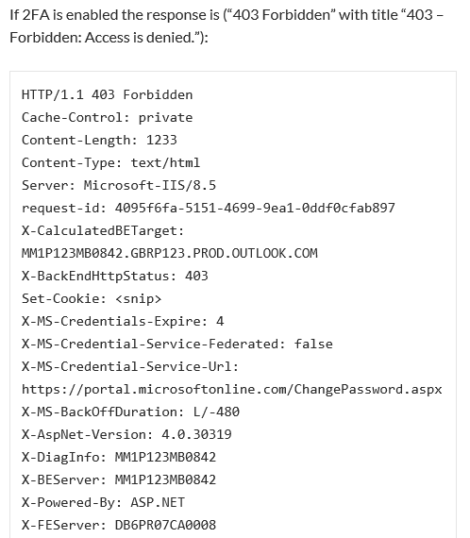
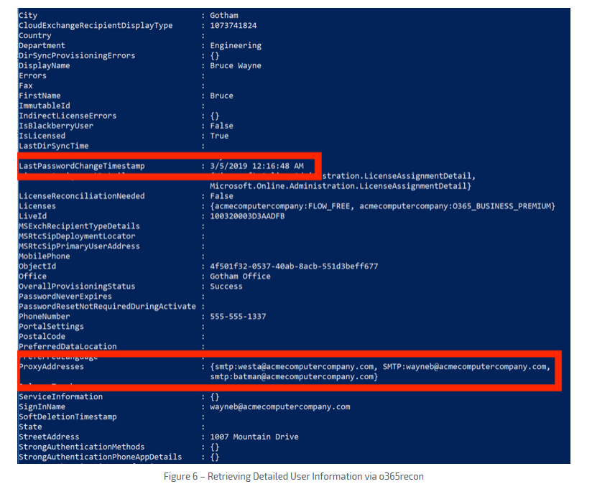
Recon: O365Recon via ActiveSync
https://www.trustedsec.com/2019/05/owning-o365-through-better-brute-forcing/
https://grimhacker.com/2017/07/24/office365-activesync-username-enumeration/

Slide 11
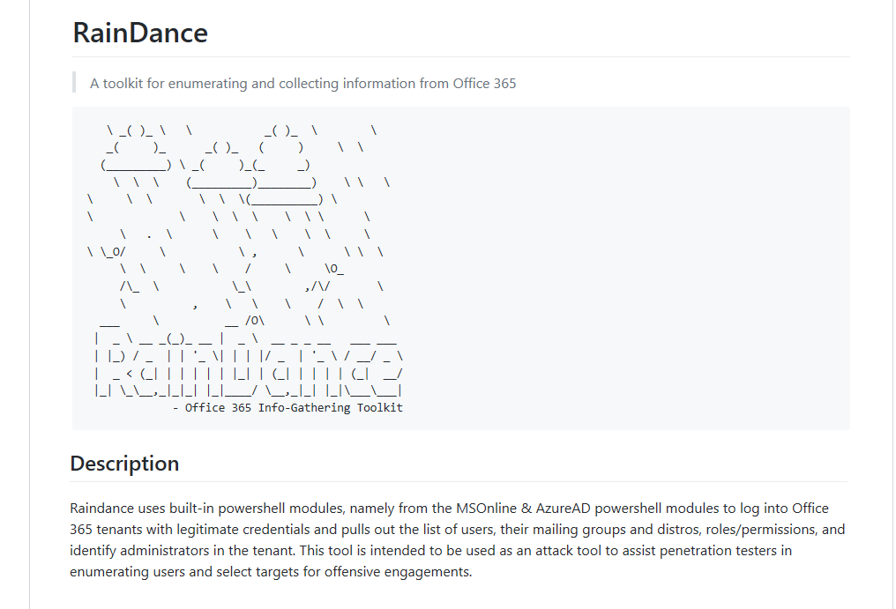
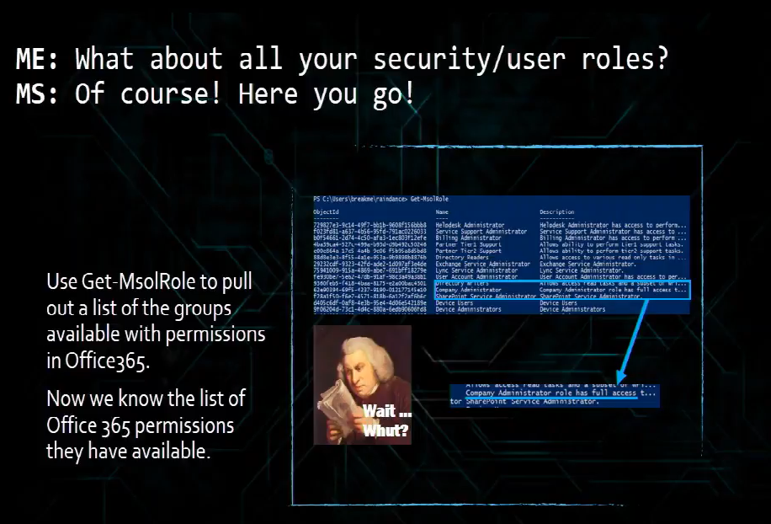
Recon: Enumeration with RainDance
https://github.com/True-Demon/raindance
https://www.youtube.com/watch?v=VHPZ2YU351M

Slide 12
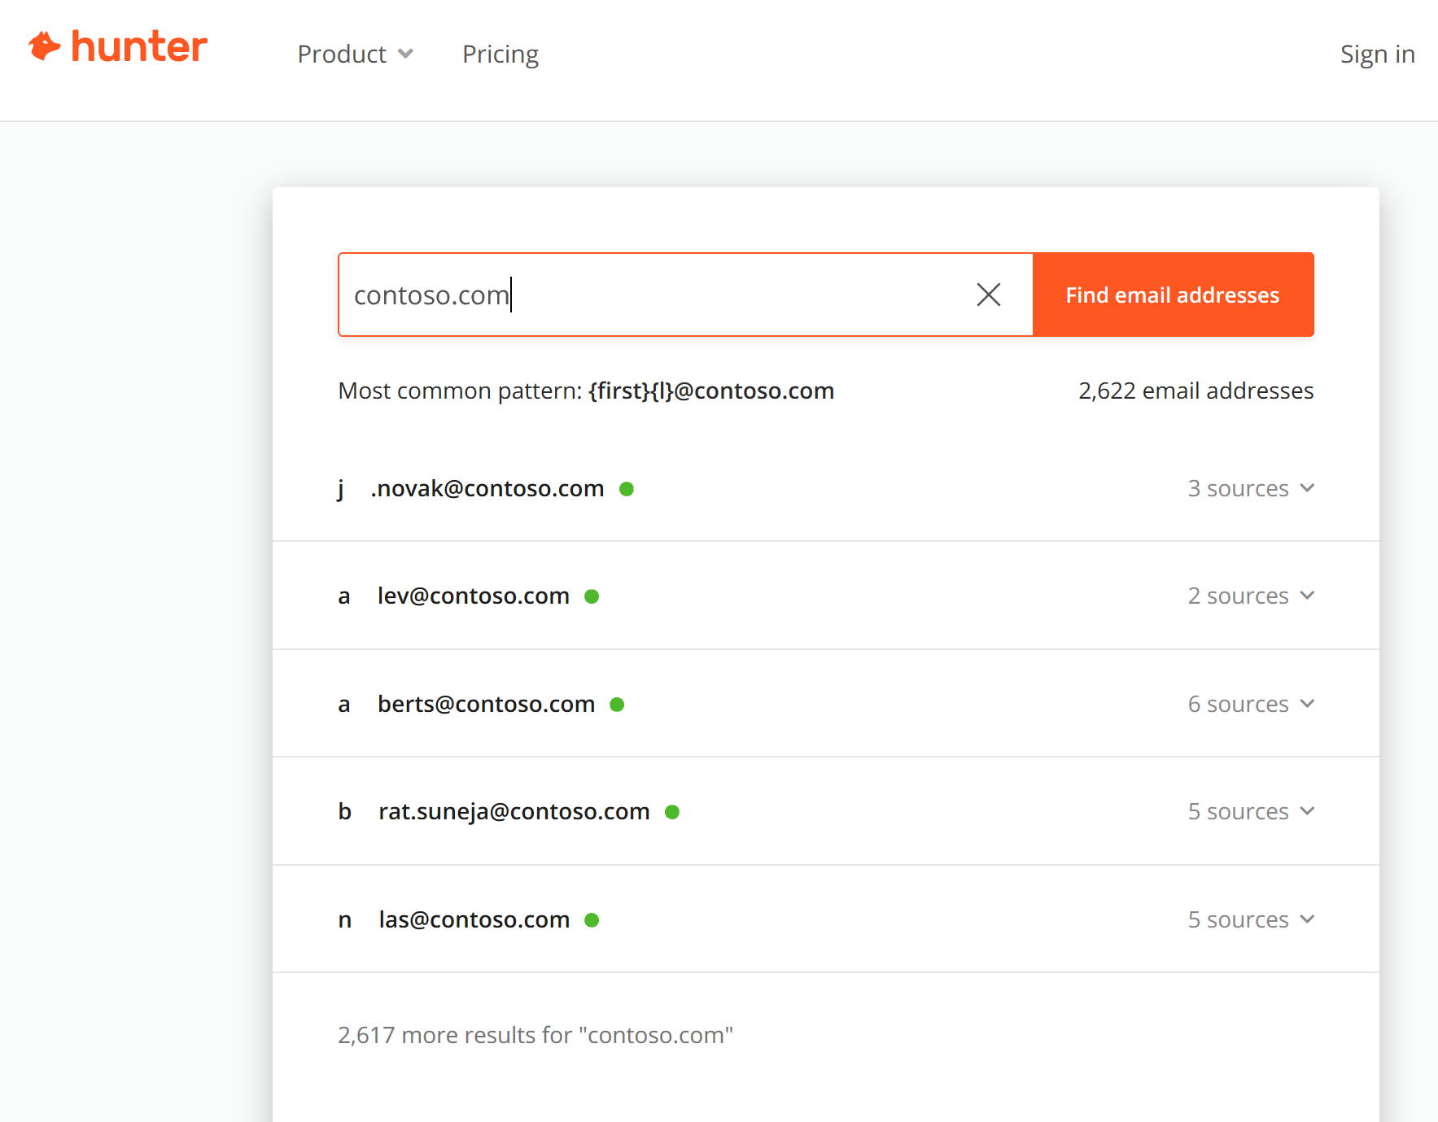
Find users with Hunter.IO
https://hunter.io/

Slide 13
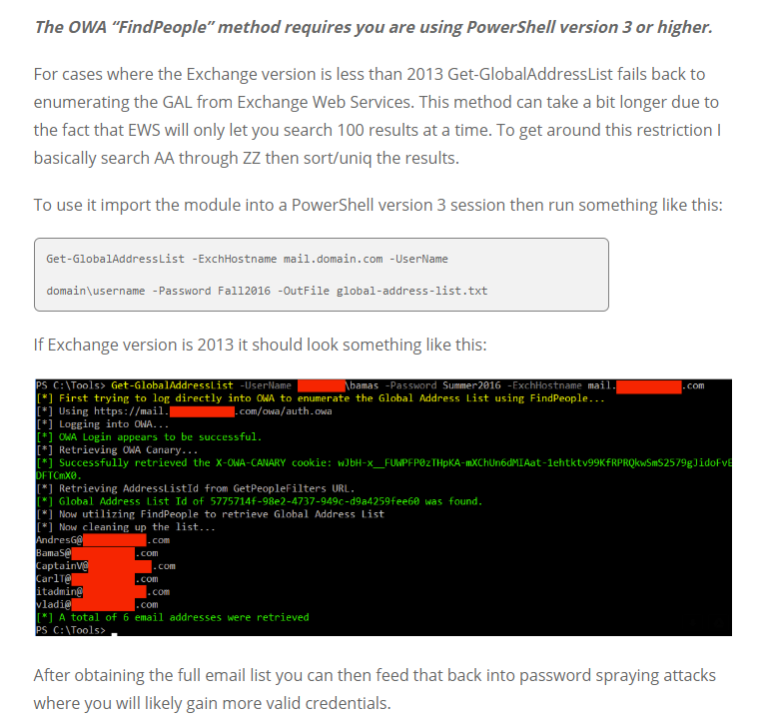
Recon: OWA FindPeople
https://www.blackhillsinfosec.com/attacking-exchange-with-mailsniper/

Slide 14
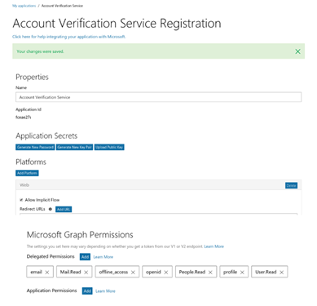
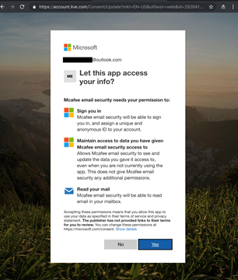
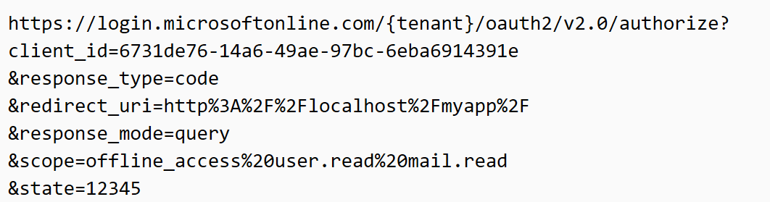
Phishing: 2FA bypass with OAuth Phishing
Step 1: Attacker registers an app with AAD with permission to read user mailbox
Step 2: Attacker crafts a mail with a link to authorize the app
Note: the URL is entirely hosted at Microsoft making it trickier to know it is a phishing site
Step 3: User tricked into consenting to app permission request
NO USER CREDENTIALS REQUIRED. ATTACKER ACCESS PERSISTS AFTER CREDENTIAL RESET
Gmail OAuth example: https://content.fireeye.com/m-trends/rpt-m-trends-2017 , Bypassing Multi-Factor Authentication for Corporate Email Theft

Slide 15
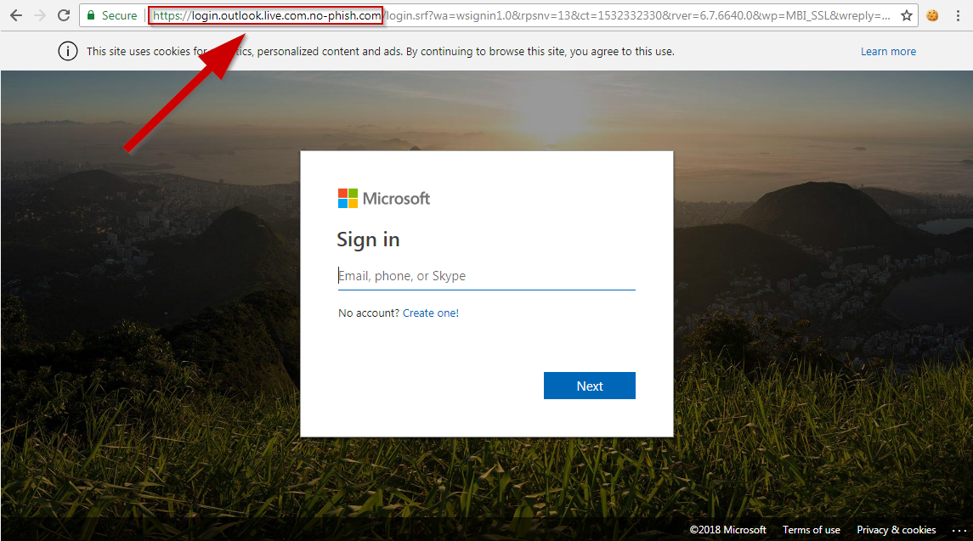
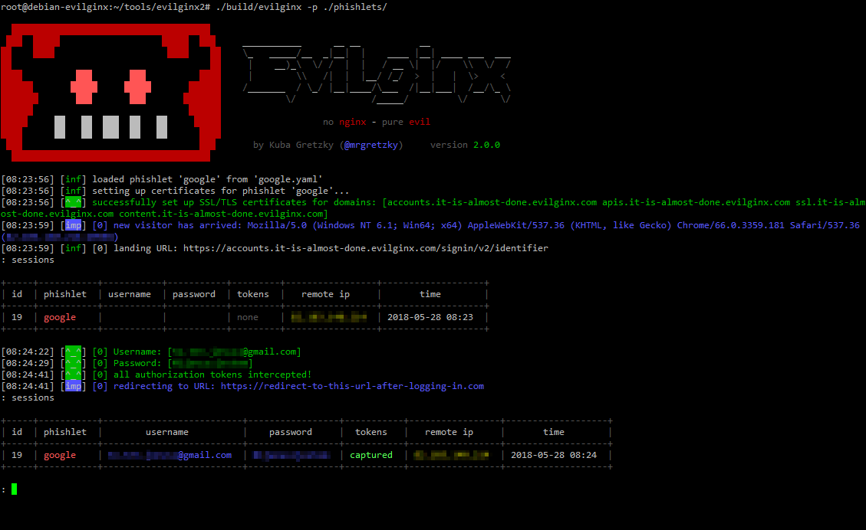
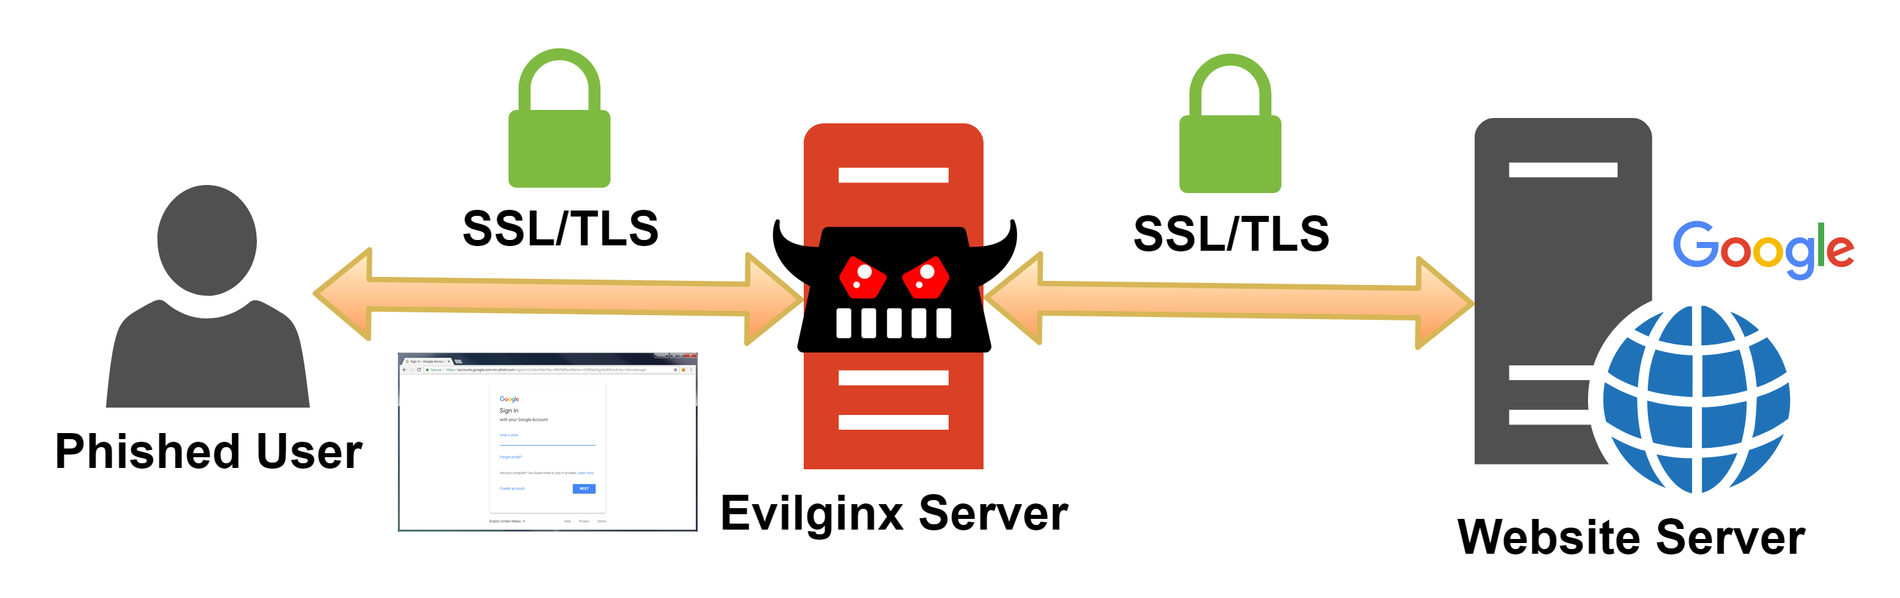
Phishing: 2FA Bypass with MITM Evilginx2
Victim receive the 2FA code
Cookie is intercepted by Evilginx
https://breakdev.org/evilginx-2-next-generation-of-phishing-2fa-tokens/

Slide 16
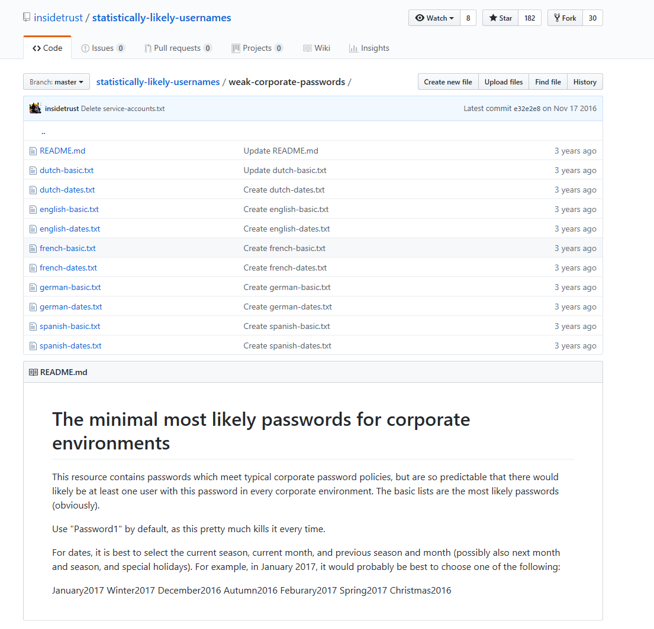
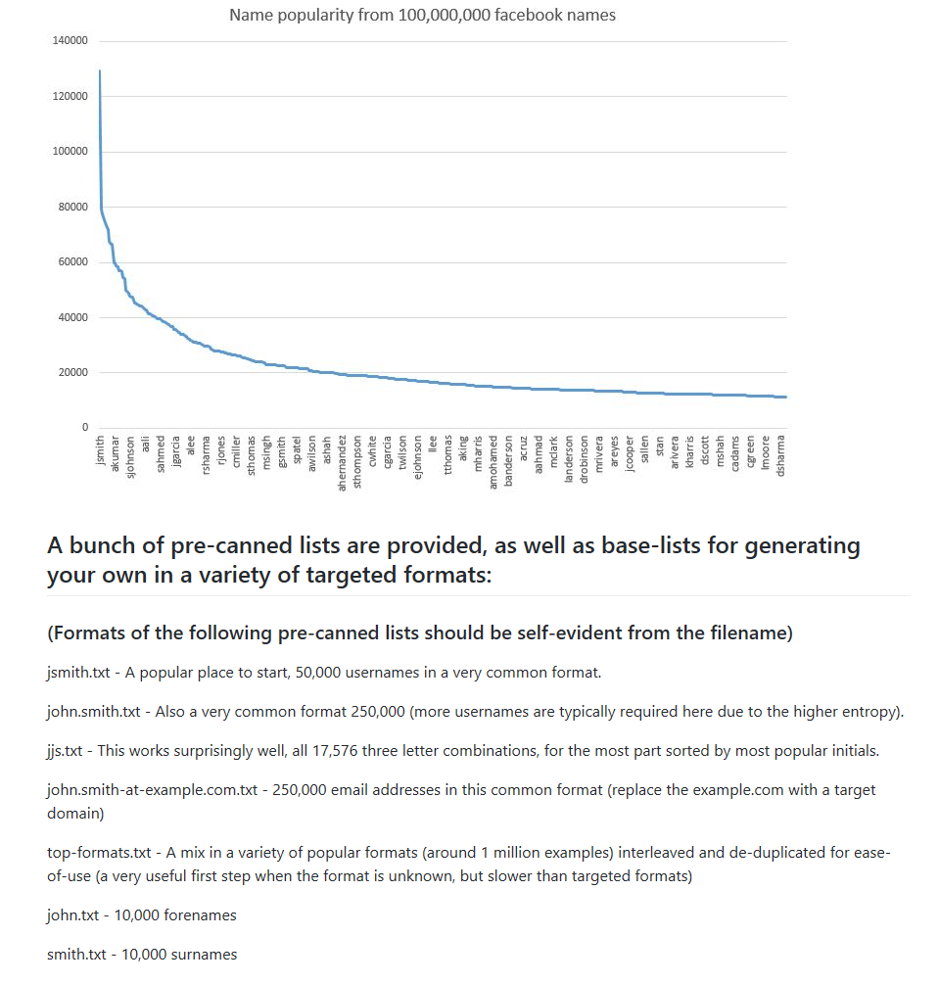
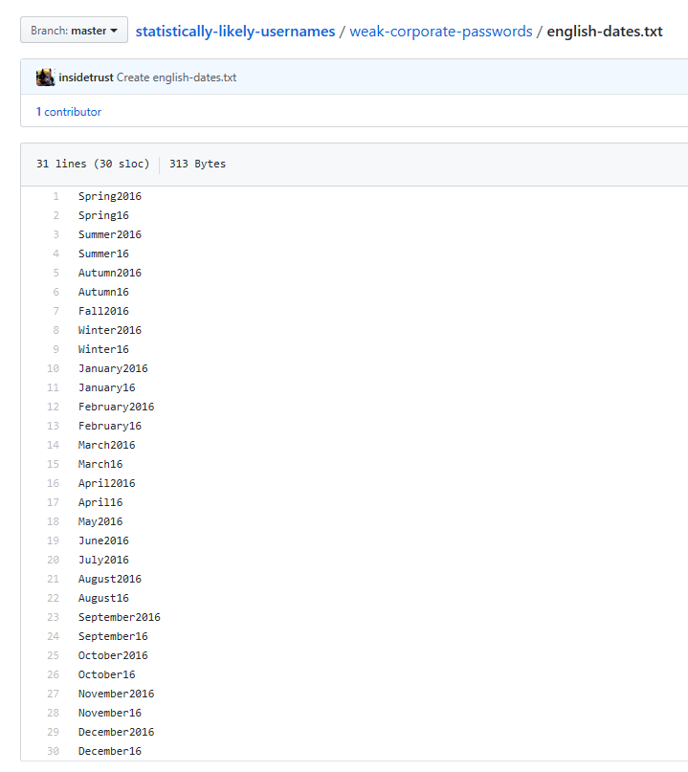
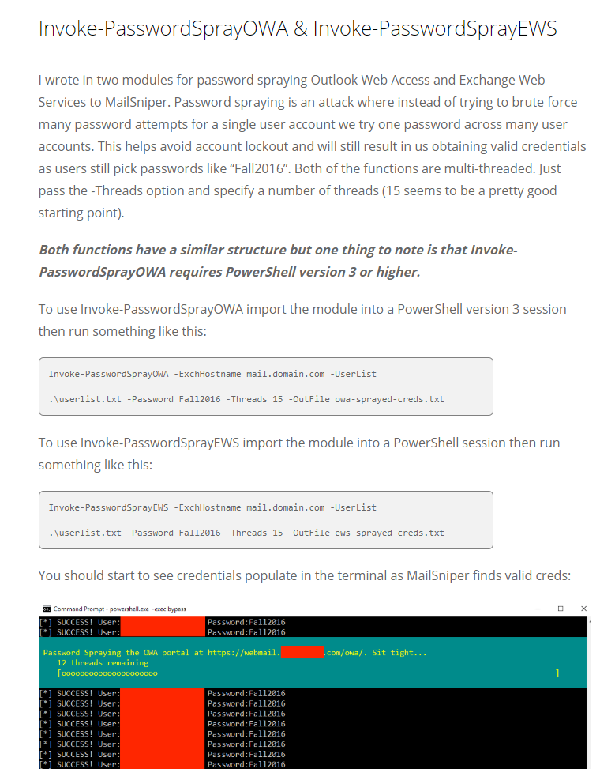
Password Spray (on steroids)

Slide 17
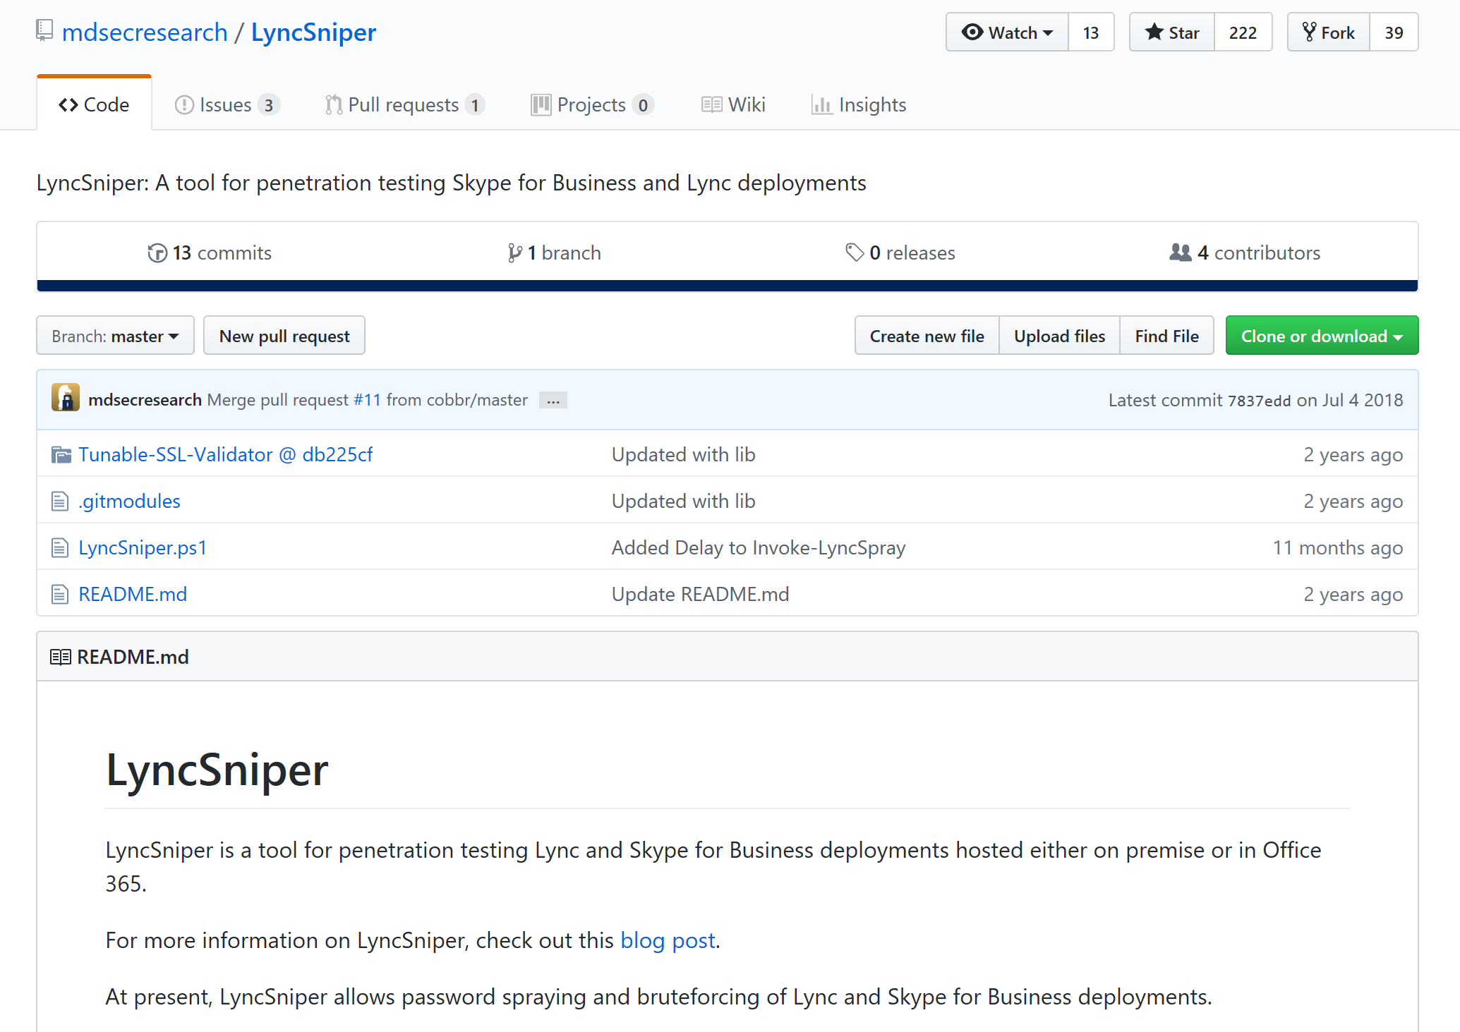
Password spraying and brute forcing of Lync and Skype for Business
https://github.com/mdsecresearch/LyncSniper

Slide 18
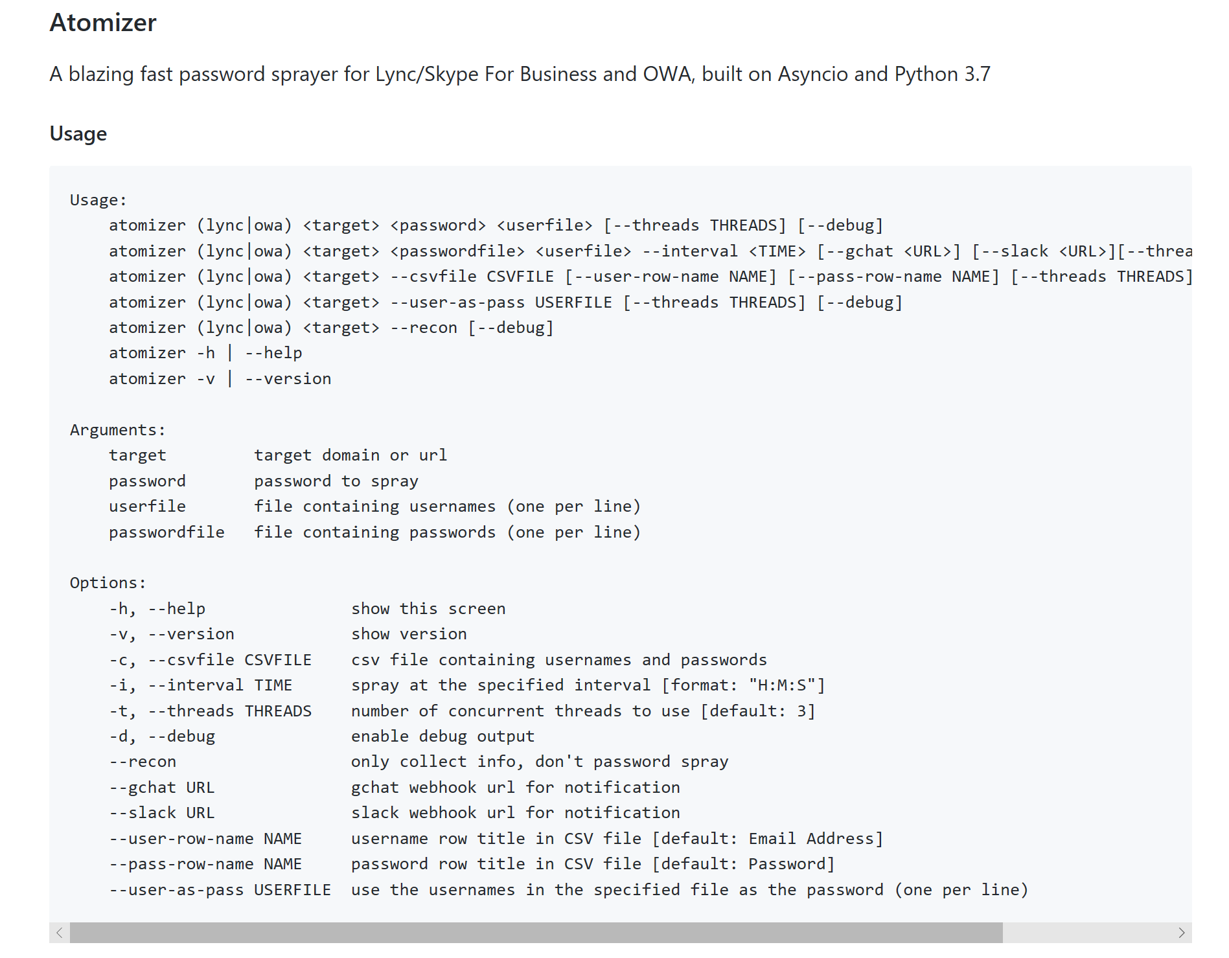
Password sprayer for Lync/Skype For Business and OWA
https://github.com/byt3bl33d3r/SprayingToolkit

Slide 19
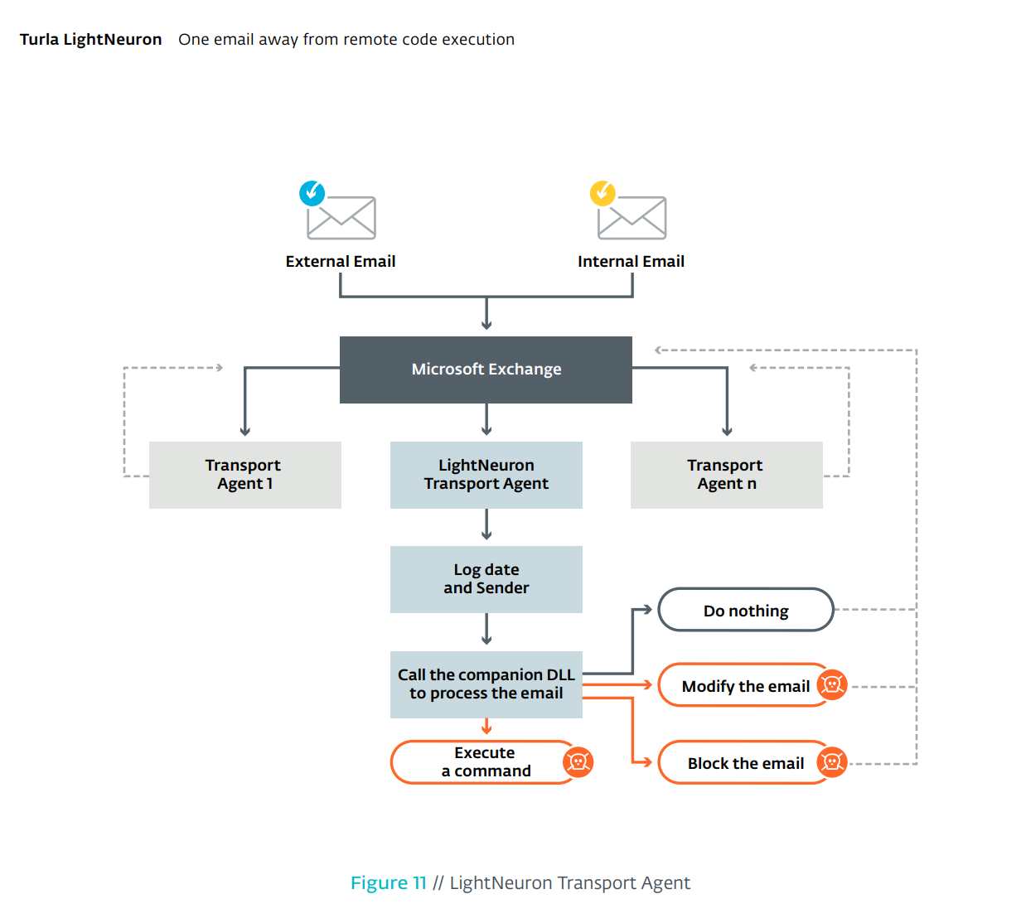
Persistence (On-prem Exchange)
https://www.welivesecurity.com/wp-content/uploads/2019/05/ESET-LightNeuron.pdf

Slide 20
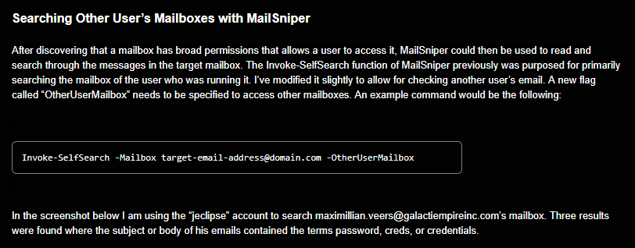
Actions on Intent: Searching Inbox for Content

Slide 21
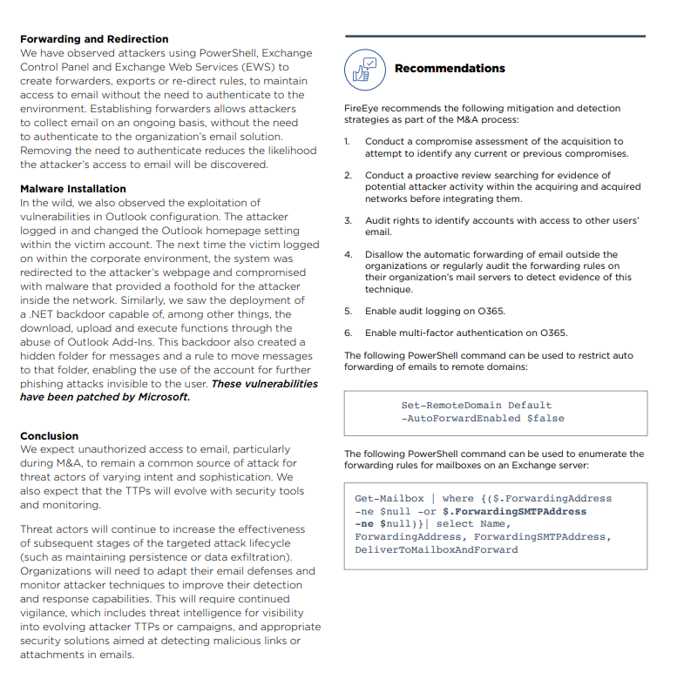
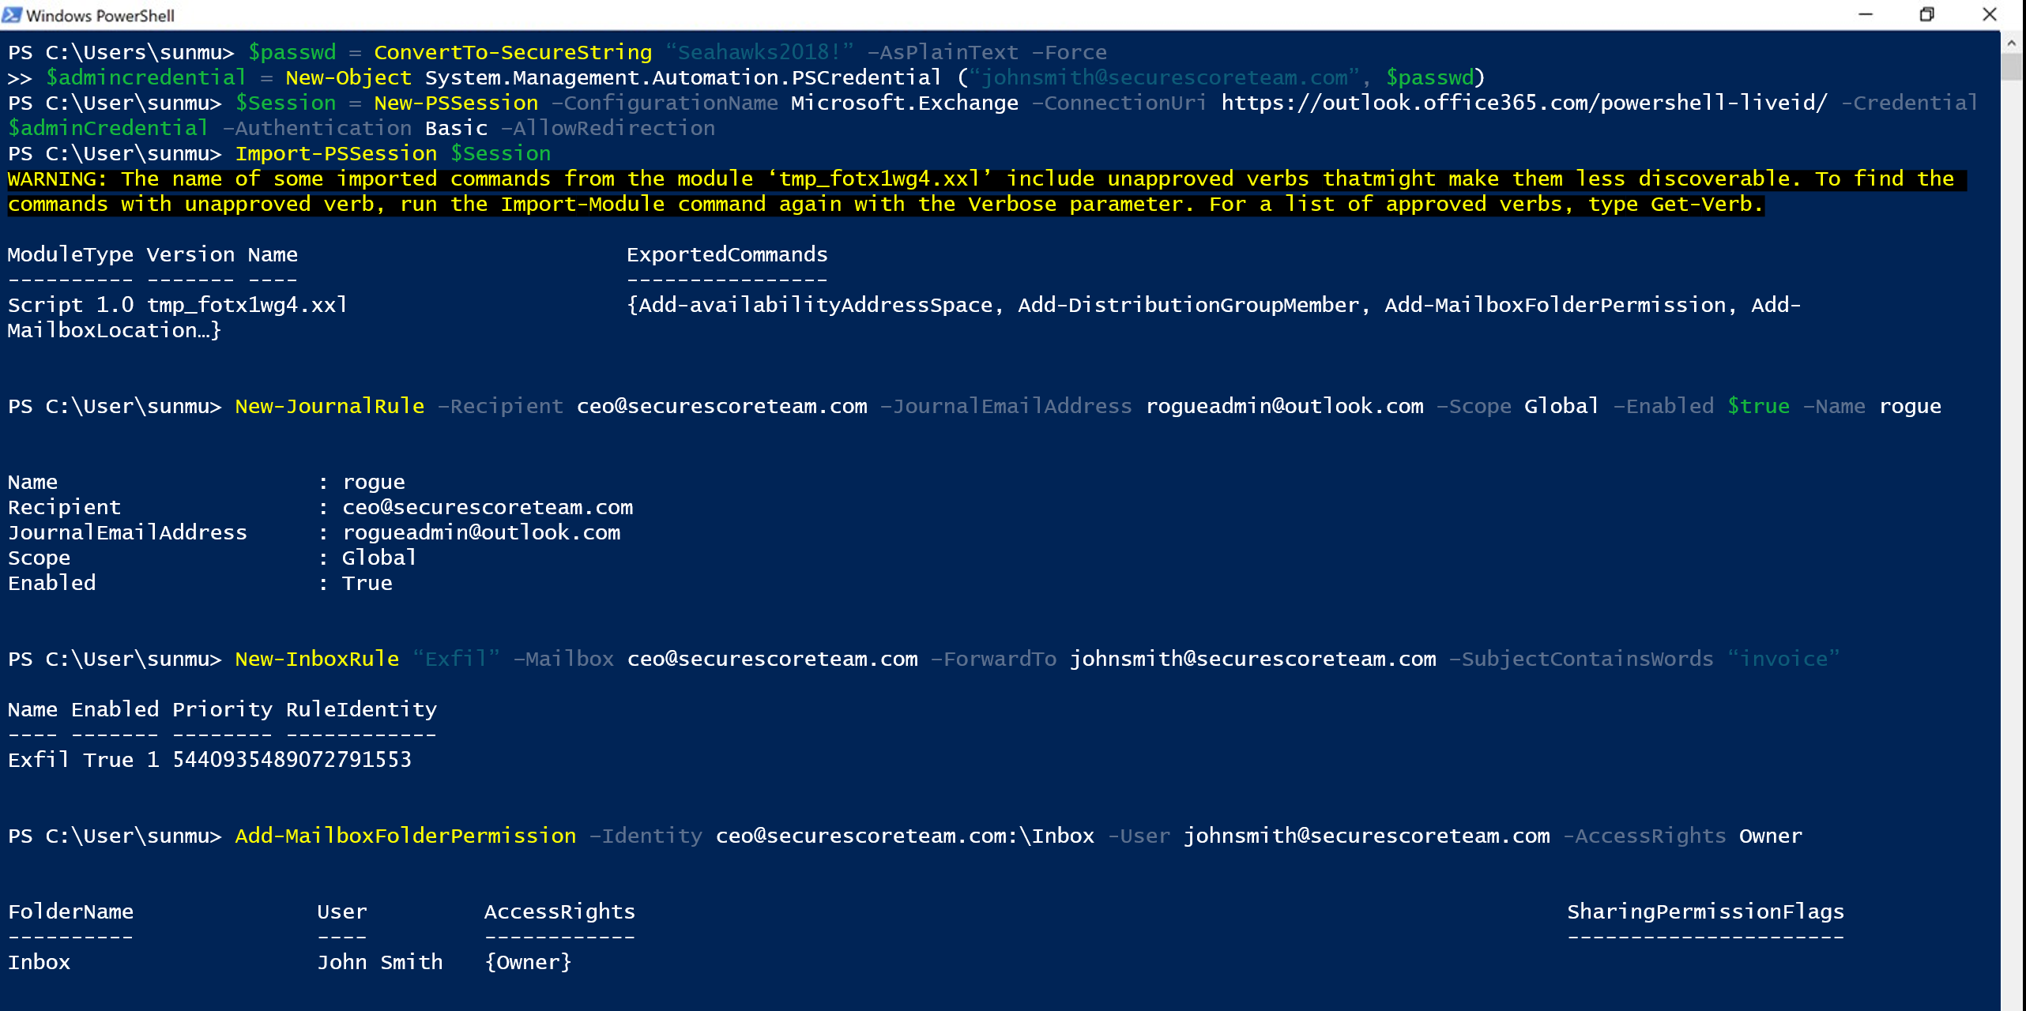
Actions on Intent: Forwarding email
https://content.fireeye.com/m-trends/rpt-m-trends-2019

Slide 22
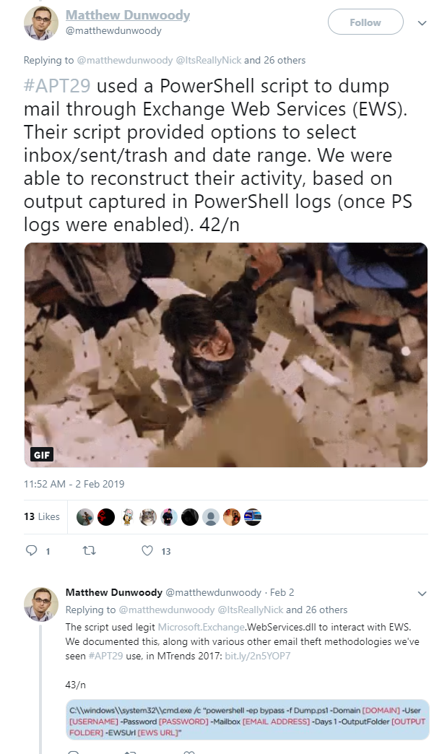
Actions on Intent: Exfiltrate e-mail
https://twitter.com/matthewdunwoody/status/1091786455851167749 (the whole thread is a gem)

Slide 23
Endpoint and Cloud attacks

Slide 24
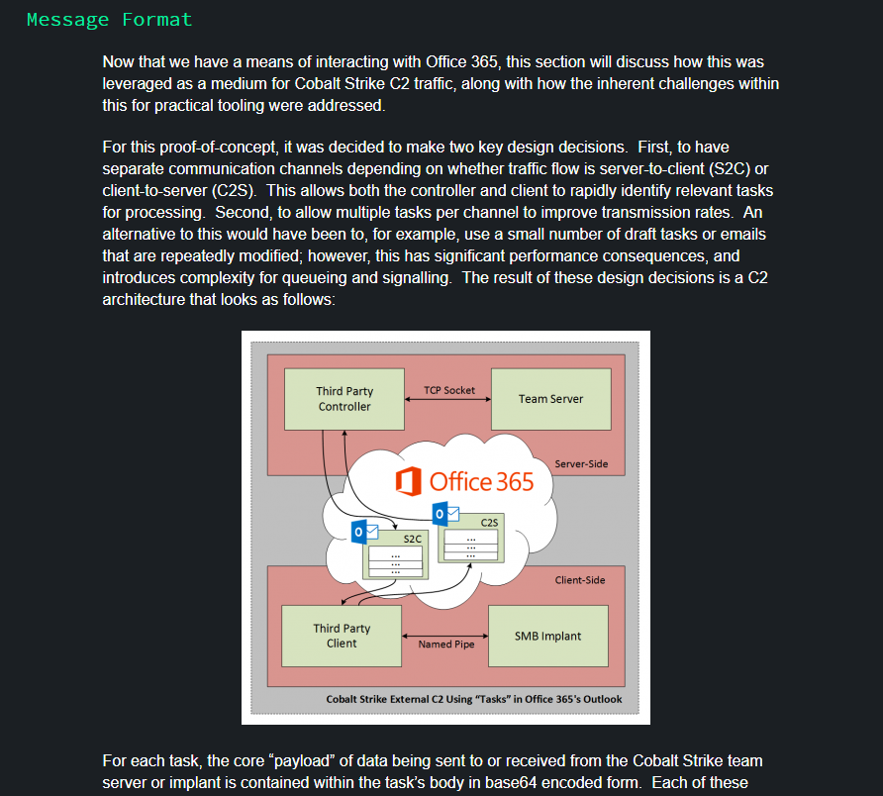
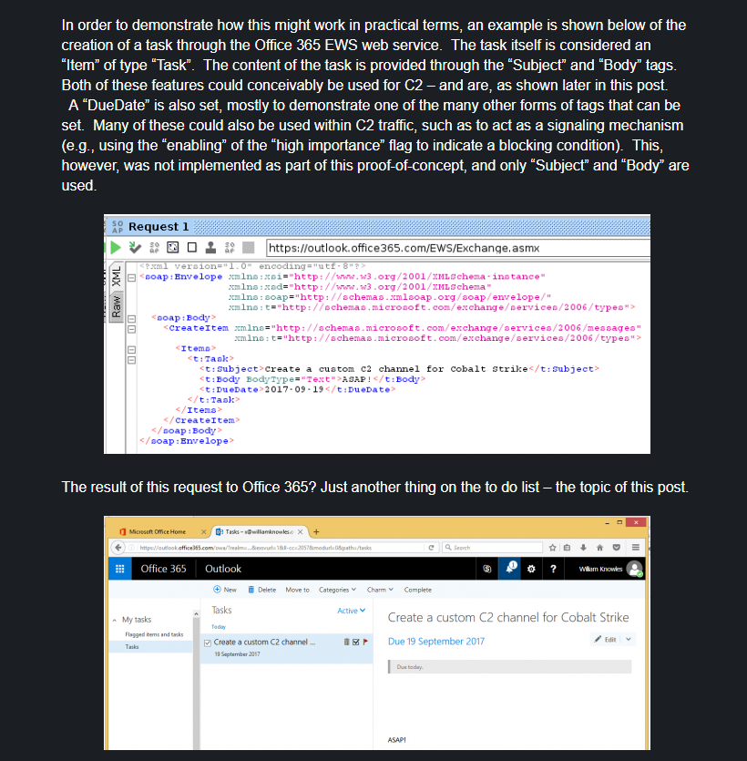
Endpoint: Outlook Tasks for C2
https://labs.mwrinfosecurity.com/blog/tasking-office-365-for-cobalt-strike-c2/

Slide 25
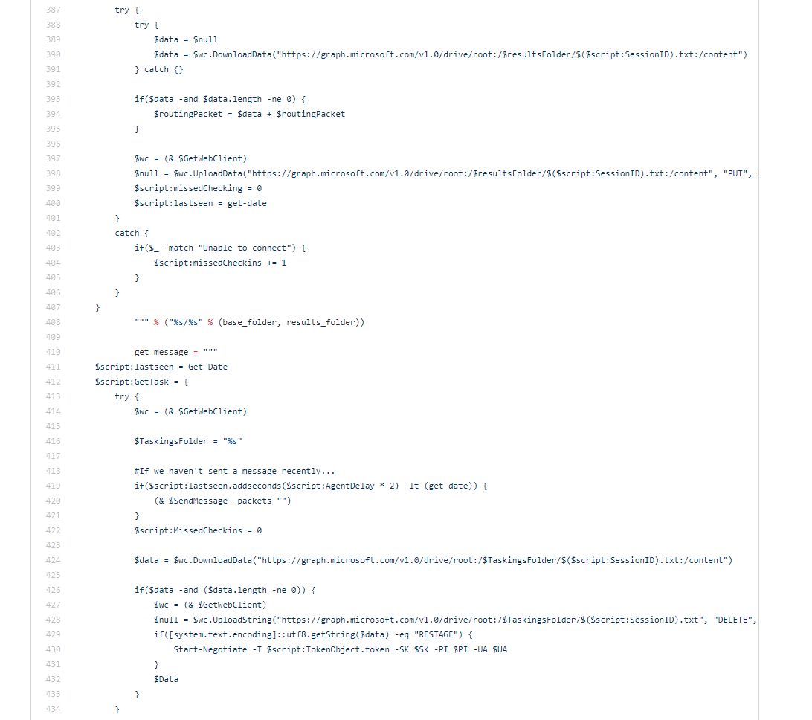
Command and Control: OneDrive & Graph API
https://github.com/EmpireProject/Empire/blob/e37fb2eef8ff8f5a0a689f1589f424906fe13055/lib/listeners/onedrive.py
https://gist.github.com/mr64bit/3fd8f321717c9a6423f7949d494b6cd9

Slide 26
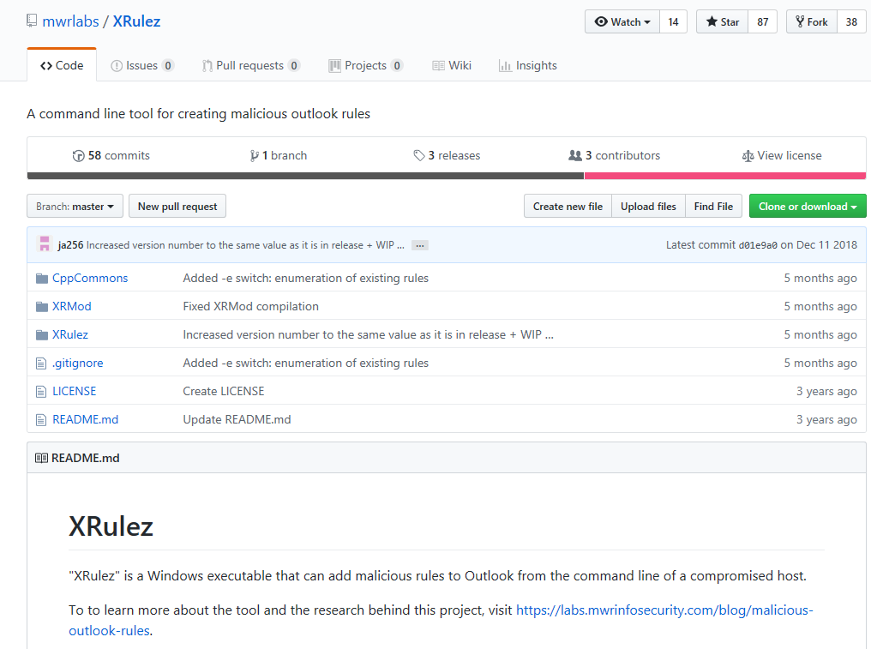
Creating malicious outlook rules
https://github.com/mwrlabs/XRulez

Slide 27
References

Slide 28
Reading List
https://www.blackhillsinfosec.com/red-teaming-microsoft-part-1-active-directory-leaks-via-azure/
https://www.trustedsec.com/2017/08/attacking-self-hosted-skype-businessmicrosoft-lync-installations/
CAS Authentication Timing Attack http://h.foofus.net/?p=784
https://investors.fireeye.com/static-files/b7dcb16f-44a8-4cfb-927f-efeed397dd52
https://www.slideshare.net/DouglasBienstock/shmoocon-2019-becs-and-beyond-investigating-and-defending-office-365 (youtube)
https://www.splunk.com/blog/2018/08/31/i-azure-you-this-will-be-useful.html
https://docs.microsoft.com/en-us/office365/securitycompliance/detailed-properties-in-the-office-365-audit-log
https://www.splunk.com/blog/2018/08/27/the-future-is-cloudy-with-a-chance-of-microsoft-office-365.html
https://www.splunk.com/blog/2017/07/27/splunking-microsoft-cloud-data-part-1.html
https://twitter.com/matthewdunwoody/status/1091786455851167749
https://labs.mwrinfosecurity.com/blog/tasking-office-365-for-cobalt-strike-c2/
DEF CON 25 - Gerald Steere, Sean Metcalf - Hacking the Cloud (youtube, slides)
Business Email Compromise on O365 (https://www.youtube.com/watch?v=JMFB4TodjkE)
https://blogs.technet.microsoft.com/cloudready/2018/10/14/email-phishing-protection-guide-part-14-prevent-brute-force-and-spray-attacks-in-office-365/
Andrew Johnson / Sacha Faust - Cloud Post Exploitation Techniques @ Infiltrate 2017, https://vimeo.com/214855977
https://www.mdsec.co.uk/2017/04/penetration-testing-skype-for-business-exploiting-the-missing-lync/
When Clouds Collide (slides)
Proofpoint: Threat actors leverage credential dumps, phishing, and legacy email protocols to bypass MFA and breach cloud accounts worldwide
Bypassing inline filtering by security services [O365 user voice]
Hiding in Plain Sight: Using the Office 365 Activities API to Investigate Business Email Compromises by CrowdStrike
Using O365 Activities API for Incident Response
Office365 ActiveSync Username Enumeration by GrimHacker
Extracting Sign-in data from O365
eDiscovery Search https://docs.microsoft.com/en-us/Exchange/policy-and-compliance/ediscovery/create-searches?view=exchserver-2019
https://adsecurity.org/wp-content/uploads/2019/04/2019-BSidesCharm-YouMovedtoOffice365NowWhat-Metcalf.pdf
2FA MITM Phishing Toolkit Evilginx2 Tools
https://www.trustedsec.com/2019/05/owning-o365-through-better-brute-forcing/
https://github.com/nyxgeek/lyncsmash [slides]
RainDance: O365 User Enumeration tool [tool]
Researchers to follow:
https://twitter.com/fullmetalcache
https://twitter.com/doughsec/
https://twitter.com/MadeleyJosh
https://twitter.com/matthewdunwoody/
https://twitter.com/mwrlabs
https://twitter.com/meansec
https://twitter.com/domchell
https://twitter.com/vysecurity
https://twitter.com/dafthack
https://twitter.com/PyroTek3
https://twitter.com/_staaldraad
https://twitter.com/byt3bl33d3r
https://twitter.com/nyxgeek
https://twitter.com/grimhacker
https://twitter.com/TRUExDEMON [RainDance]

